Slide 1

SUSTAINABILITY AND DEVELOPMENT
19115103-19115108

Slide 2

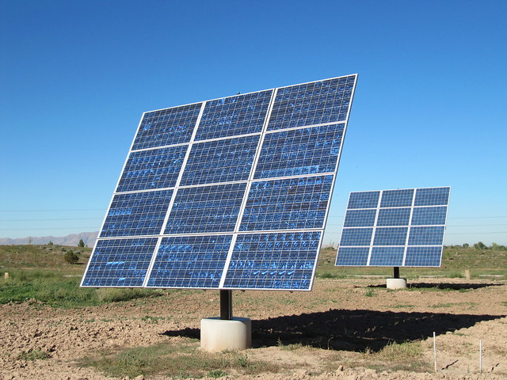
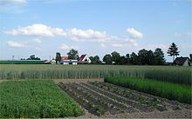

EXAMPLES OF SUSTAINBALE DEVELOPMENT

Slide 3
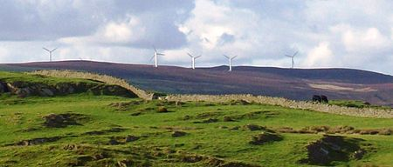
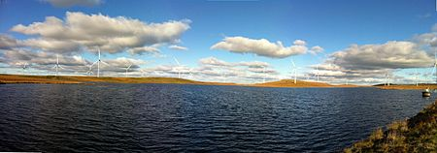
WIND ENERGY
Wind energy is the use of wind to provide the mechanical power through wind turbines to turn electric generators and provide energy. Wind power is a sustainable and renewable energy.

Slide 4
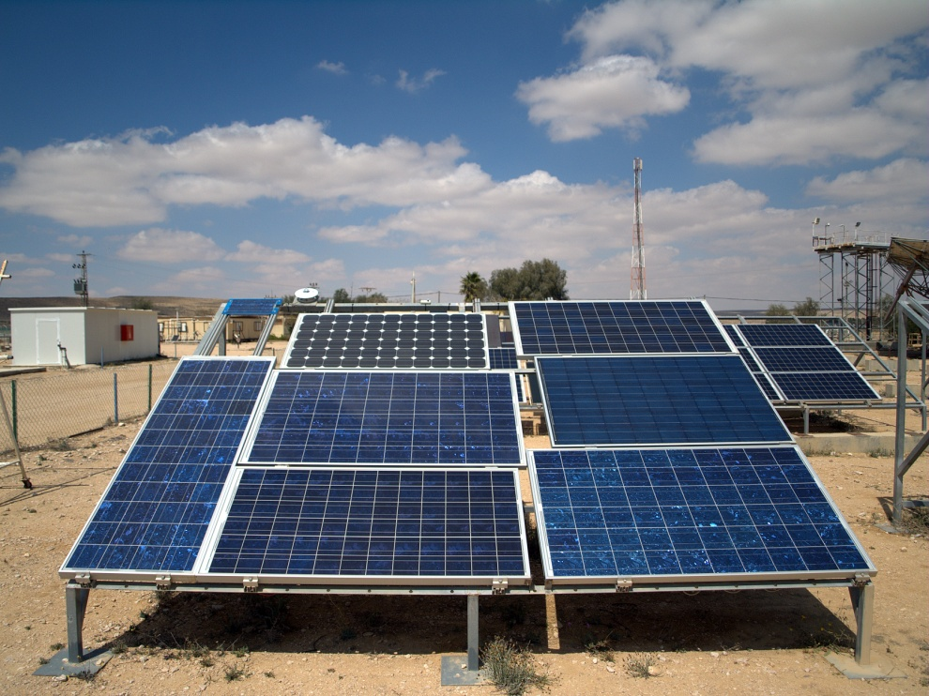
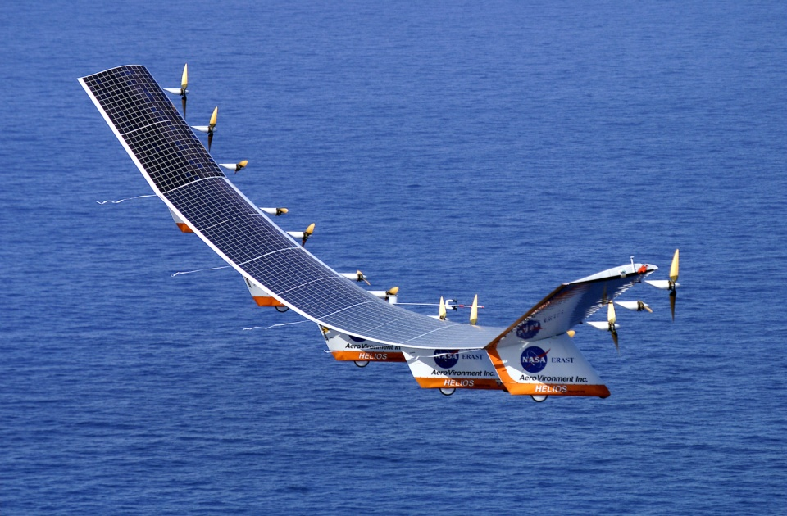
SOLAR ENERGY
Solar energy is radiant light and heat from the Sun that is harnessed using a range of ever-evolving technologies such as solar heating, photovoltaics, solar thermal energy, solar architecture, molten salt power plants and artificial photosynthesis.

Slide 5
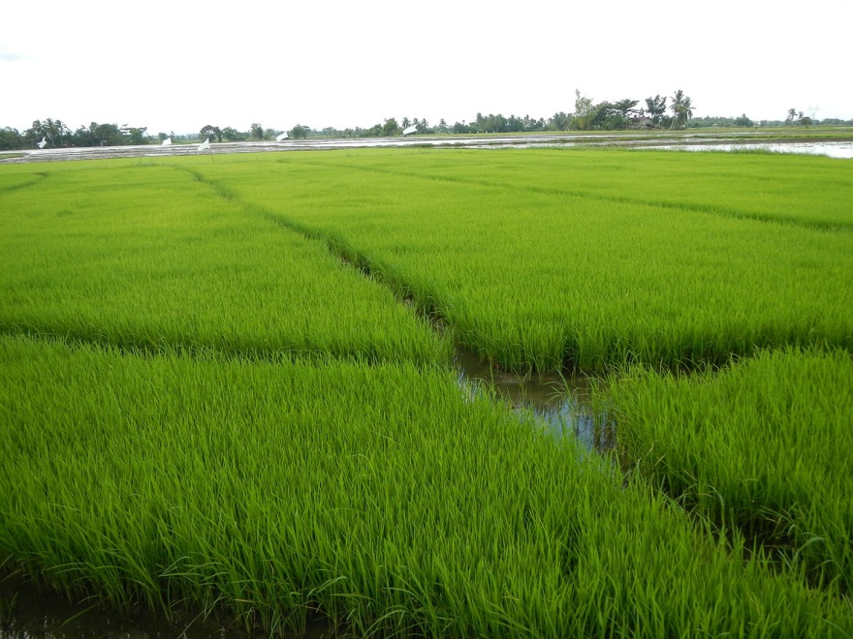
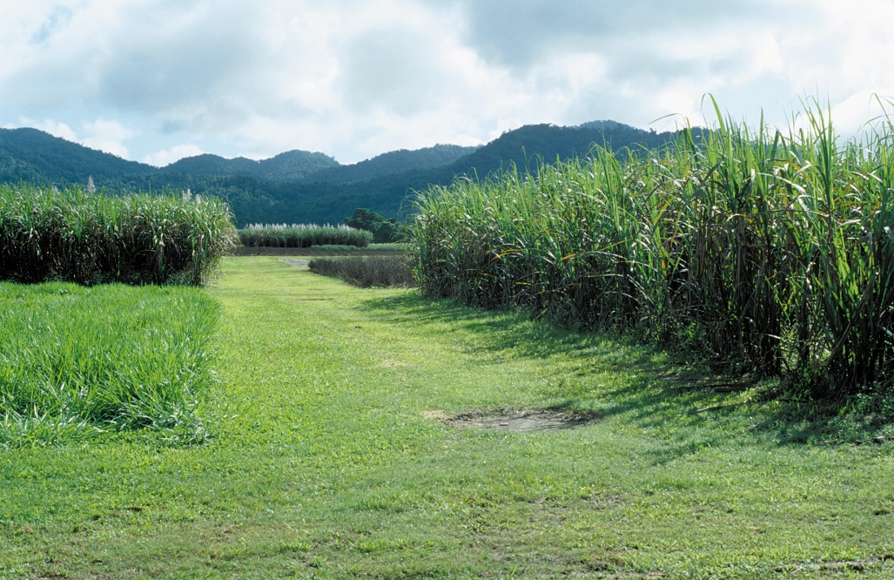
CROP ROTATION
Crop rotation is the practice of growing a series of dissimilar or different types of crops in the same area in sequenced seasons. It is done so that the soil of farms is not used for only one set of nutrients. It helps in reducing soil erosion and increases soil fertility and crop yield.

Slide 6
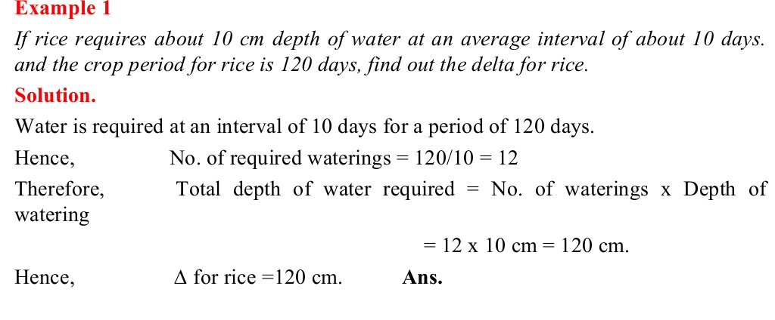
NUMERICALS

Slide 7
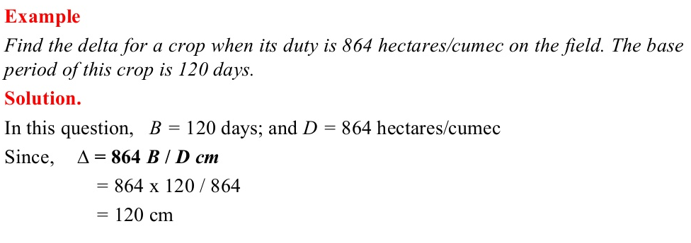

Slide 8
CASE STUDIES
Air Pollution / Transport
IIT-Roorkee to work on energy efficiency with Power-grid Corp

Slide 9
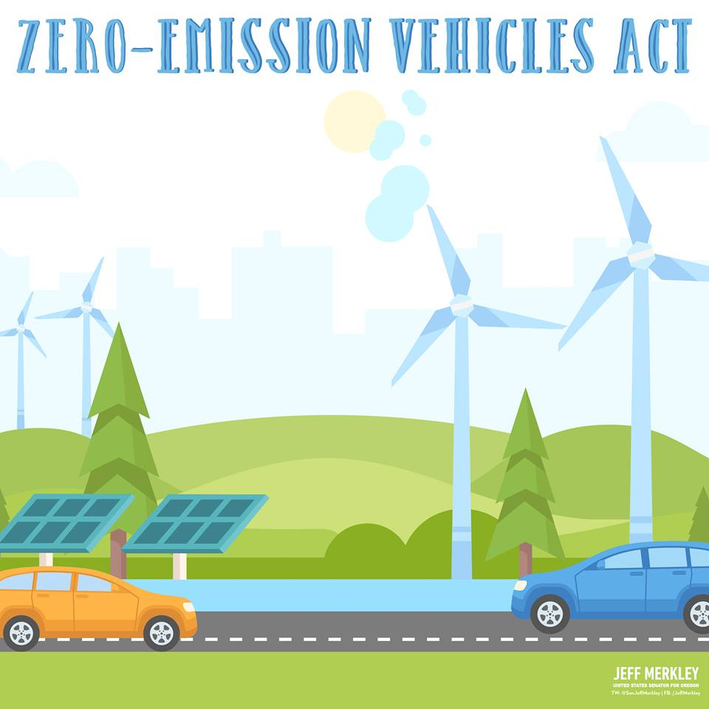
AIR POLLUTION/TRANSPORT
During the late 1980s it became clear that California's growing air pollution problem could not improve without some very significant changes.
One of the most progressive solutions laid on the table was the further development of zero emission vehicles (ZEVs).

Slide 10
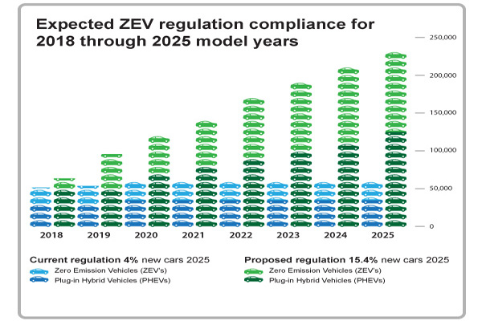
The government offered a 10% tax credit (up to $ 4,000) at the cost of a ZEV. The California Energy Commission began funding the Electric Vehicle Loan Program which provides an electric vehicle.
A number of local incentives for ZEV have also been established in the last two years.

Slide 11
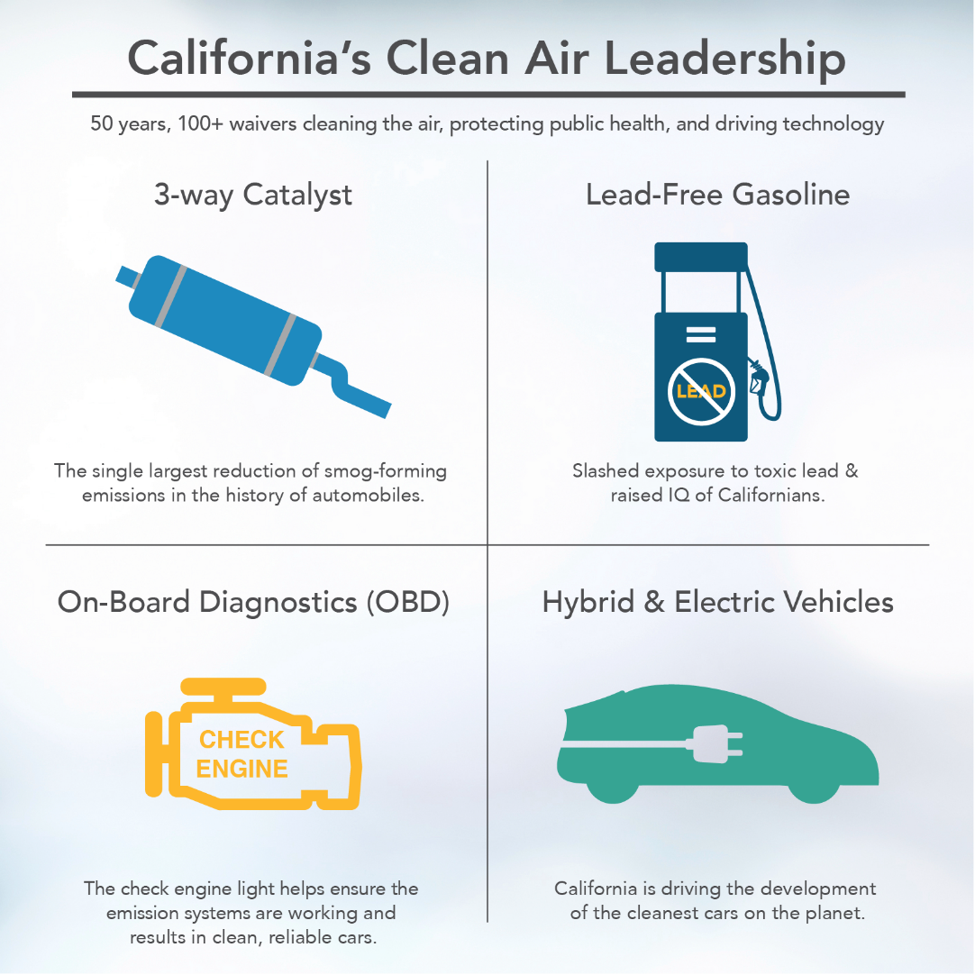
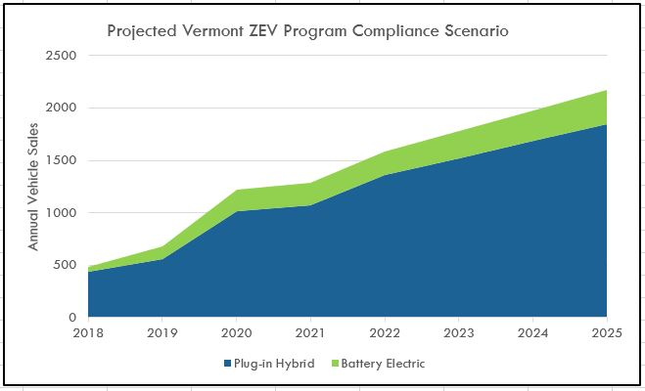
Low emission vehicles and clean fuel regulations include requirements that outline ZEV production for the seven largest auto producers through the year 2003. As per the original plan, ZEVs would be 2% of total production in 1998, 5% in 2001 and 10%.
To help auto manufacturers meet these regulations, economic incentives were created at the federal, state, and local levels.

Slide 12

IIT ROORKEE TO WORK ON ENERGY EFFICIENCY WITH POWER-GRID CORP
The Indian Institute of Technology (IIT) Roorkee on 12th July, 2019 signed an MoU with power Grid Corporation of India Ltd (power-grid), state-run utility, on energy efficiency and sustainable energy. The MoU targets to bring together academic and industry/corporate prowess, in building efficient, reliable and low-cost energy systems.

Slide 13
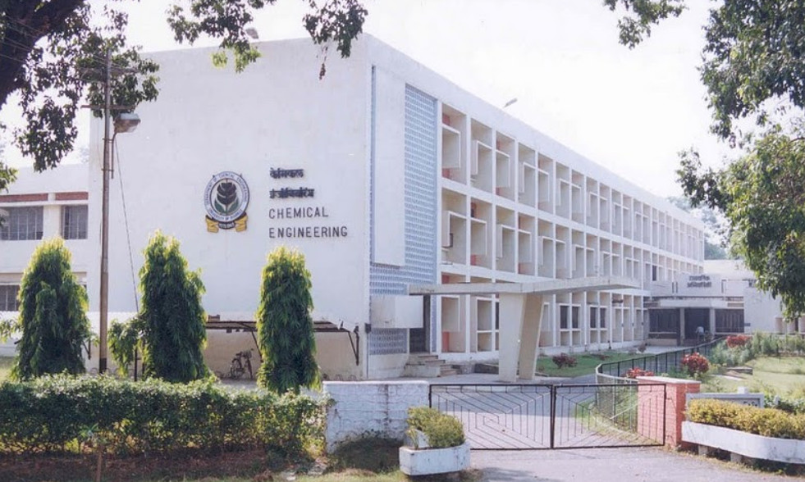
According to Sanjay Garg, Executive Director, POWERGRID, thanked IIT Roorkee for entrusting their company with this prestigious association. "IIT Roorkee is the first-ever academic institution for which POWERGRID will be providing cost-effective state of the art energy efficiency solutions. With this collaboration, we believe that there is going to be a lot of learning for our team members too," he said.

Slide 14

SUSTAINABILITY
Sustainability assessment (SA) is one of the most complex types of appraisal methodologies. Not only this does entail multidisciplinary aspects (environmental, economic and social), but also cultural and value-based elements. Besides, SA is usually conducted for supporting decision making and policy development in a broad context.

Slide 15
Principles of Sustainability
1)The First Principle:
Contain entropy and ensure that the flow of resources, through and within the economy, is as nearly non-declining as is permitted by physical laws
2)The Second Principle:
Adopt an appropriate accounting system, fully aligned with the planet's ecological processes and reflecting true, comprehensive biospheric pricing to guide the economy.

Slide 16
3)The Third Principle:
Ensure that the essential diversity of all forms of life in the Biosphere is maintained.
4)The Fourth Principle:
Maximize degrees of freedom and potential self-realization of all humans without any individual or group, adversely affecting others.
5)The Fifth Principle:
-Maximize degrees of freedom and potential
-Recognize the seamless, dynamic continuum

Slide 17
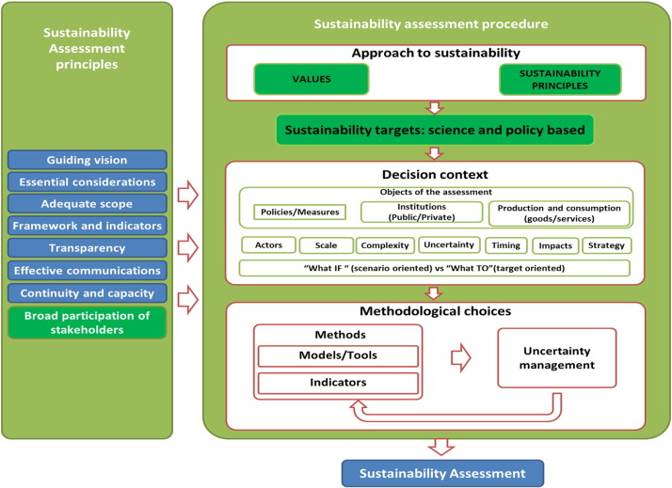
Procedure-
The SA procedure comprises several steps, based on the definition of : the approach to sustainability, the sustainability targets, the decision context and the methodological choices for the assessment. This is the core of the SA framework. It is composed of different phases:

Slide 18
Identification of the most suitable assessment methodologies (and related methods,3 models, tools, and indicators);
Sensitivity and uncertainty analysis of the assessment framework;
Definition of monitoring strategies to track progress towards sustainability

Slide 19
ABOUT US
103 – Rohan Mallick
104 – Rohit Garde
105 – Rohitaksh choudhary
106 – Shanmathi S
107 – Ketan Suhaas
108 - Sachin Agrawal

